Slide 1

Virtual CT Scanner Team 7
Prof. Tsekos

Slide 2
Iliana Chevez Sami Ahmed Sameer Salman Tulsiben Patel
Team 7

Slide 3
Virtual CT Scanner
Test/Validation Phantoms Generation
Scanner Controls & Image Reconstruction
Operation of the Scanner
Graphical User Interface
Image Analysis

Slide 4
Phantom Generation

Slide 5
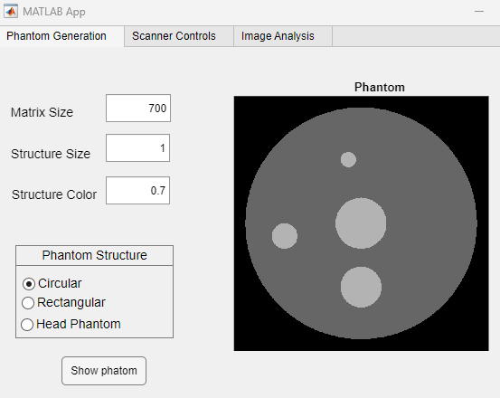
Phantom Generation
Phantom Generation Module: Located in the first panel of the GUI.
Phantom Selection: Users can select the type of phantom under the “Phantom Structure” section.
Circular Phantom: Generates a phantom with a series of circular structures.
Rectangular Phantom: Generates a phantom with a rectangular structure.
Head Phantom: Generates a head phantom.

Slide 6

Phantom Generation
Customization Options: For Circular and Rectangular phantoms, users can modify:
Matrix Size: Adjust the size of the matrix.
Structure Size: Change the size of the structures.
Structure Color: Modify the color of the structures.
Visualization: After making changes, users can click the “Show phantom” button to visualize the phantom.

Slide 7
Scanner Controls & Image Reconstruction

Slide 8
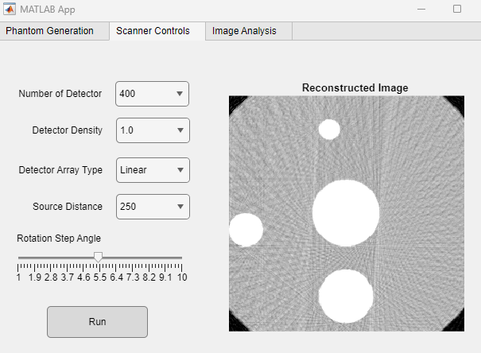
Scanner Controls
Scanner Controls Module: Located in the second panel of the GUI.
Scanner Controls Parameters: Users can select and adjust the scanner controls under the “Scanner Controls” tab.

Slide 9
Scanner Controls
Number of Detectors: Allows users to change the number of detectors used in the scanning process.
Detector Density: Enables users to adjust the density of the detectors.
Source Array Type: Users can select the type of source array used in the scanning process.
Source Distance: Users can adjust the distance of the source from the object being scanned.
Rotation Step Angle: Allows users to change the rotation step angle of the objects.

Slide 10
Scanner Controls & Reconstructed Image
Applying Changes: After making the necessary adjustments, users can click the “Run” button to apply the changes to the scanner controls.
Image Display: The right section of the panel displays the reconstructed image based on the selected scanner controls.

Slide 11
Image Analysis

Slide 12
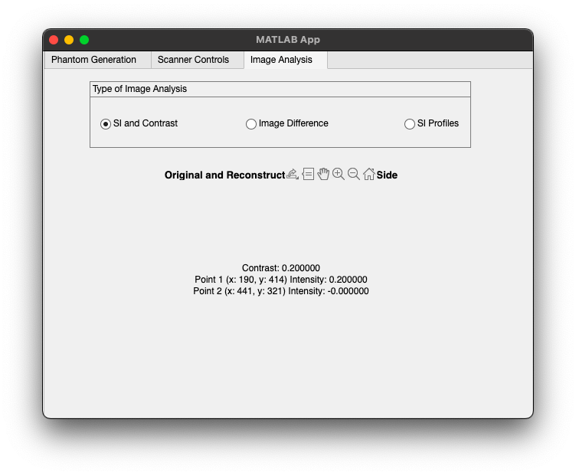

Image Analysis
Image Analysis Module: Located in the third panel of the GUI.
Image Analysis Selections: Users can select the image analysis method under the “Image Analysis” tab.
SI and Contrast
Image Difference
SI Profiles

Slide 13
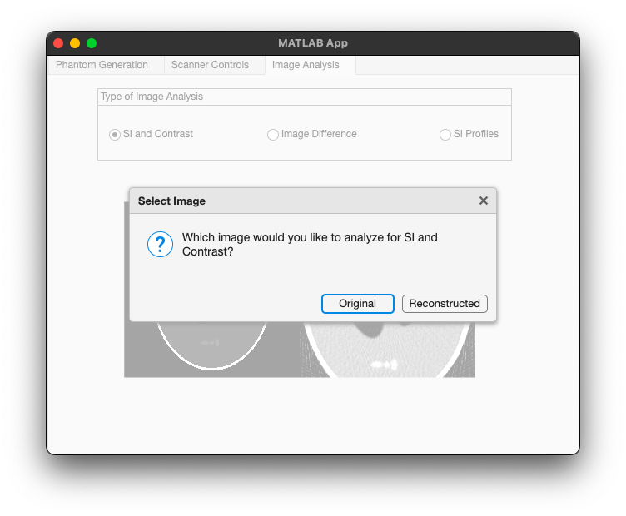
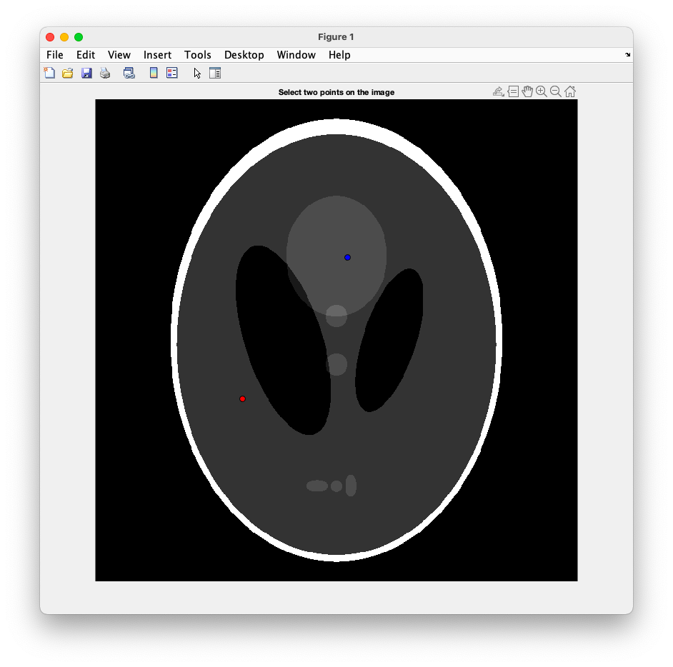
Image Analysis
SI and Contrast: Allows users to analyze the Signal Intensity (SI) and contrast of the image.
It compares two points in the image and output the contrast between them.

Slide 14
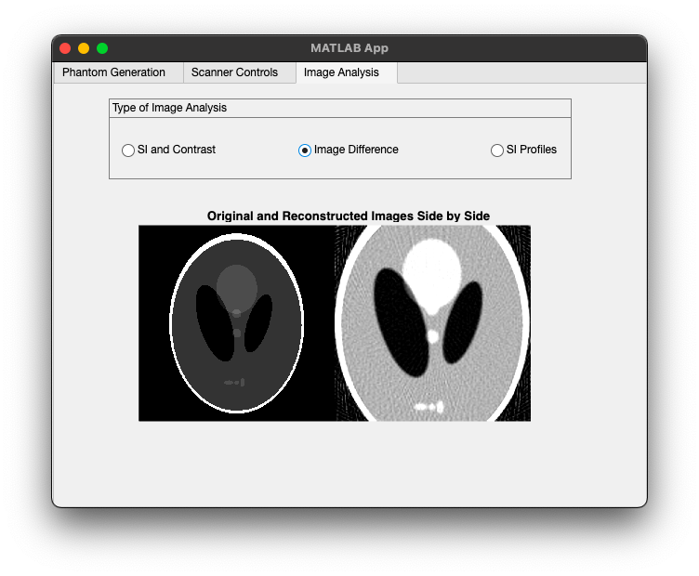
Image Analysis
Image Difference: Enables users to compare the reconstructed image generated by the scanner controls with the original input (phantom).

Slide 15
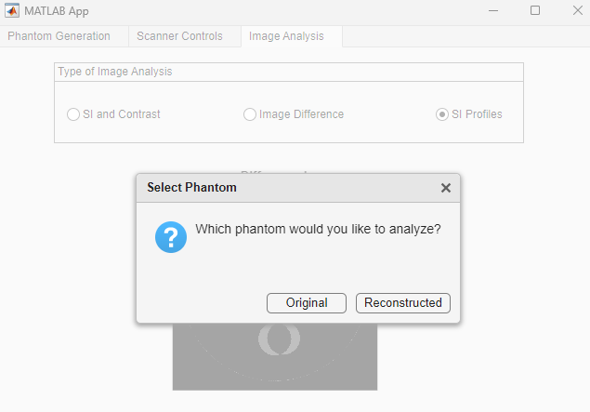
Image Analysis
SI Profiles: Users can generate graphs of the signal intensity vs. position.
When you click on SI Profiles it will show you a pop up as shown in the image.
You can select which image you want to analyze.

Slide 16
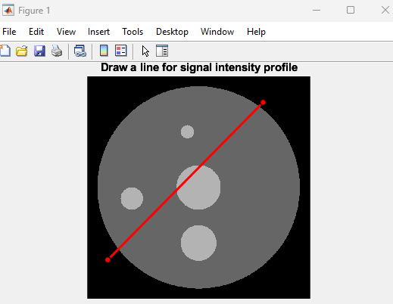
Image Analysis
After the selection is made the window in the image shown would pop up.
You can draw a line on the image to get the intensity profile.

Slide 17
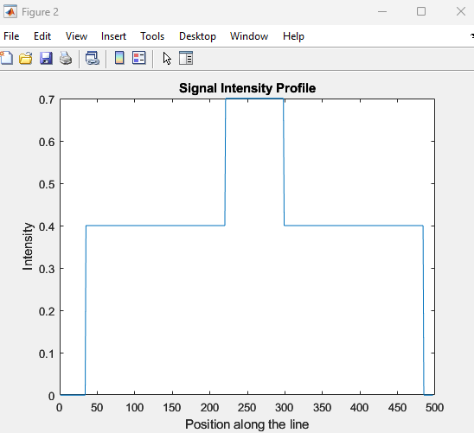
Image Analysis
Signal Intensity Profiles: this is the signal intensity profile of the line drawn on the previous slide.

